Slide 1
Introduction to Data Science
John P Dickerson
Lecture #3 – 09/08/2020
CMSC320
Tuesdays & Thursdays
5:00pm – 6:15pm (… or anytime on the Internet)

Slide 2
Announcements
Register on Piazza: piazza.com/umd/fall2020/cmsc320
238 have registered already
12 have not registered yet
If you were on Piazza, you’d know …
Project 0 is out! And is also “due” today. (Worth zero points!)
Link: https://github.com/cmsc320/fall2020/tree/master/project0
We’ve also linked some reading for the week!
Second quiz is due Tuesday at noon; on ELMS now.

Slide 3
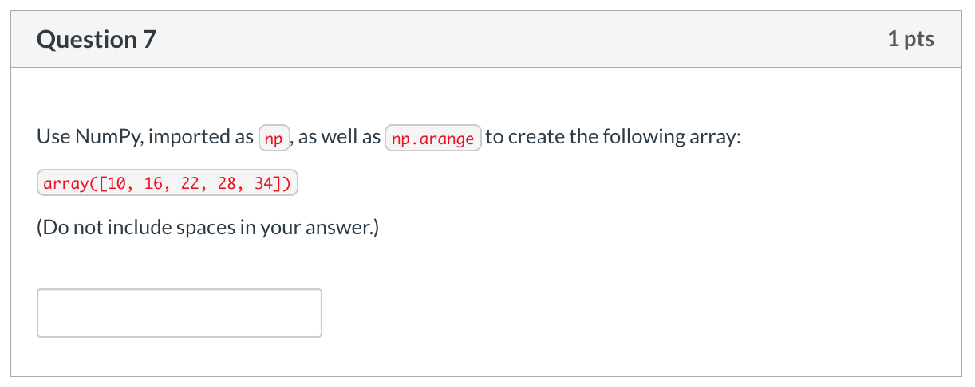
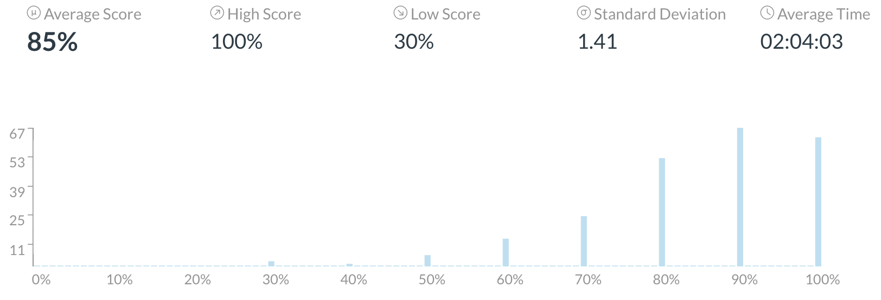
Announcements
Quiz #1, Question #7 caused some issues:
Multiple correct answers, my key missed some of them; let me know if this made difference between passing and failing

Slide 4
Announcements
Office hours will be posted tonight course webpage:
https://cmsc320.github.io/
Subject to change; I will update the course webpage if so!
Office hours are held via Zoom (shocking!) – TAs to provide details in the future, on Piazza
We have coverage for every weekday (MTWThF).
TAs will also “cover” Piazza for the working hours of the day on which they are holding office hours.

Slide 5

Very short wrap-up on “Python Stuff” from last lecture …

Slide 6
Exceptions
Syntactically correct statement throws an exception:
tweepy (Python Twitter API) returns “Rate limit exceeded”
sqlite (a file-based database) returns IntegrityError
print('Python', python_version())
try:
cause_a_NameError
except NameError as err:
print(err, '-> some extra text')

Slide 7
Python 2 vs 3
Python 3 is intentionally backwards incompatible
(But not that incompatible)
Biggest changes that matter for us:
print “statement” → print(“function”)
1/2 = 0 → 1/2 = 0.5 and 1//2 = 0
ASCII str default → default Unicode
Namespace ambiguity fixed:
i = 1
[i for i in range(5)]
print(i) # ????????
Notes:
Prints “4” in Python 2 and “1” (i.e., unchanged because the list comprehension scope is dead) in Python 3.

Slide 8
To any Curmudgeons …
If you’re going to use Python 2 anyway, use the _future_ module:
Python 3 introduces features that will throw runtime errors in Python 2 (e.g., with statements)
_future_ module incrementally brings 3 functionality into 2
https://docs.python.org/2/library/__future__.html
from _future_ import division
from _future_ import print_function
from _future_ import please_just_use_python_3

Slide 9
So, How does Import Work?
Python code is stored in module – simply put, a file full of Python code
A package is a directory (tree) full of modules that also contains a file called __init.py__
Packages let you structure Python’s module namespace
E.g., X.Y is a submodule Y in a package named X
For one module to gain access to code in another module, it must import it

Slide 10
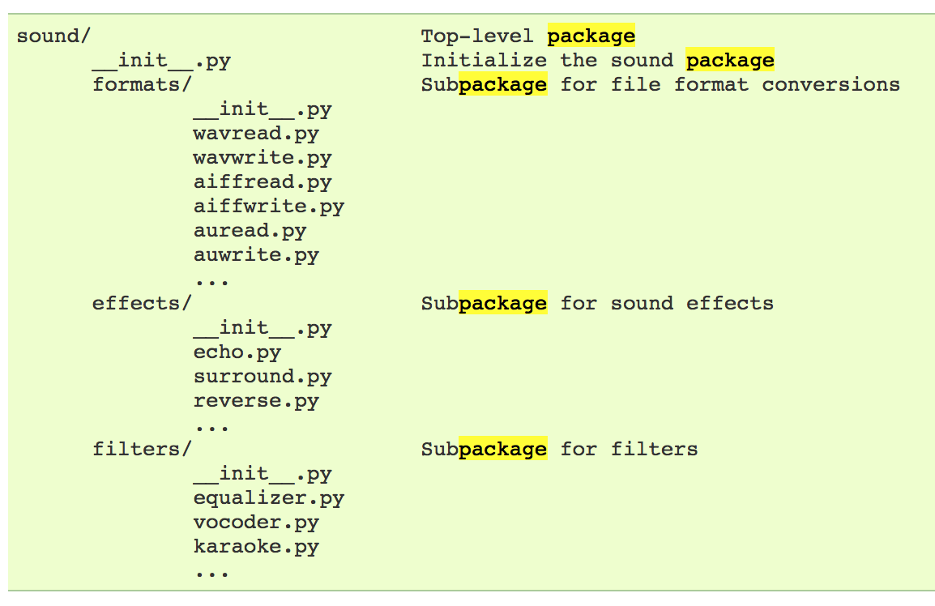
Example
# Load (sub)module sound.effects.echo
import sound.effects.echo
# Must use full name to reference echo functions
sound.effects.echo.echofilter(input, output, delay=0.7)
https://docs.python.org/2/tutorial/modules.html

Slide 11
Example
# Load (sub)module sound.effects.echo
import sound.effects.echo
# Must use full name to reference echo functions
sound.effects.echo.echofilter(input, output, delay=0.7)
# Load (sub)module sound.effects.echo
from sound.effects import echo
# No longer need the package prefix for functions in echo
echo.echofilter(input, output, delay=0.7)
# Load a specific function directly
from sound.effects.echo import echofilter
# Can now use that function with no prefix
echofilter(input, output, delay=0.7)
https://docs.python.org/2/tutorial/modules.html

Slide 12
Python vS R (For Data Scientists)
There is no right answer here!
Python is a “full” programming language – easier to integrate with systems in the field
R has a more mature set of pure stats libraries …
… but Python is catching up quickly …
… and is already ahead specifically for ML.
You will see Python more in the tech industry.

Slide 14
The Data Lifecycle
Data collection
Data processing
Exploratory analysis
&
Data viz
Analysis, hypothesis testing, & ML
Insight & Policy Decision

Slide 15
Today’s Lecture
Data collection
Data processing
Exploratory analysis
&
Data viz
Analysis, hypothesis testing, & ML
Insight & Policy Decision
with
Thanks: Zico Kolter’s 15-388, Amol Deshpande, Nick Mattei

Slide 16
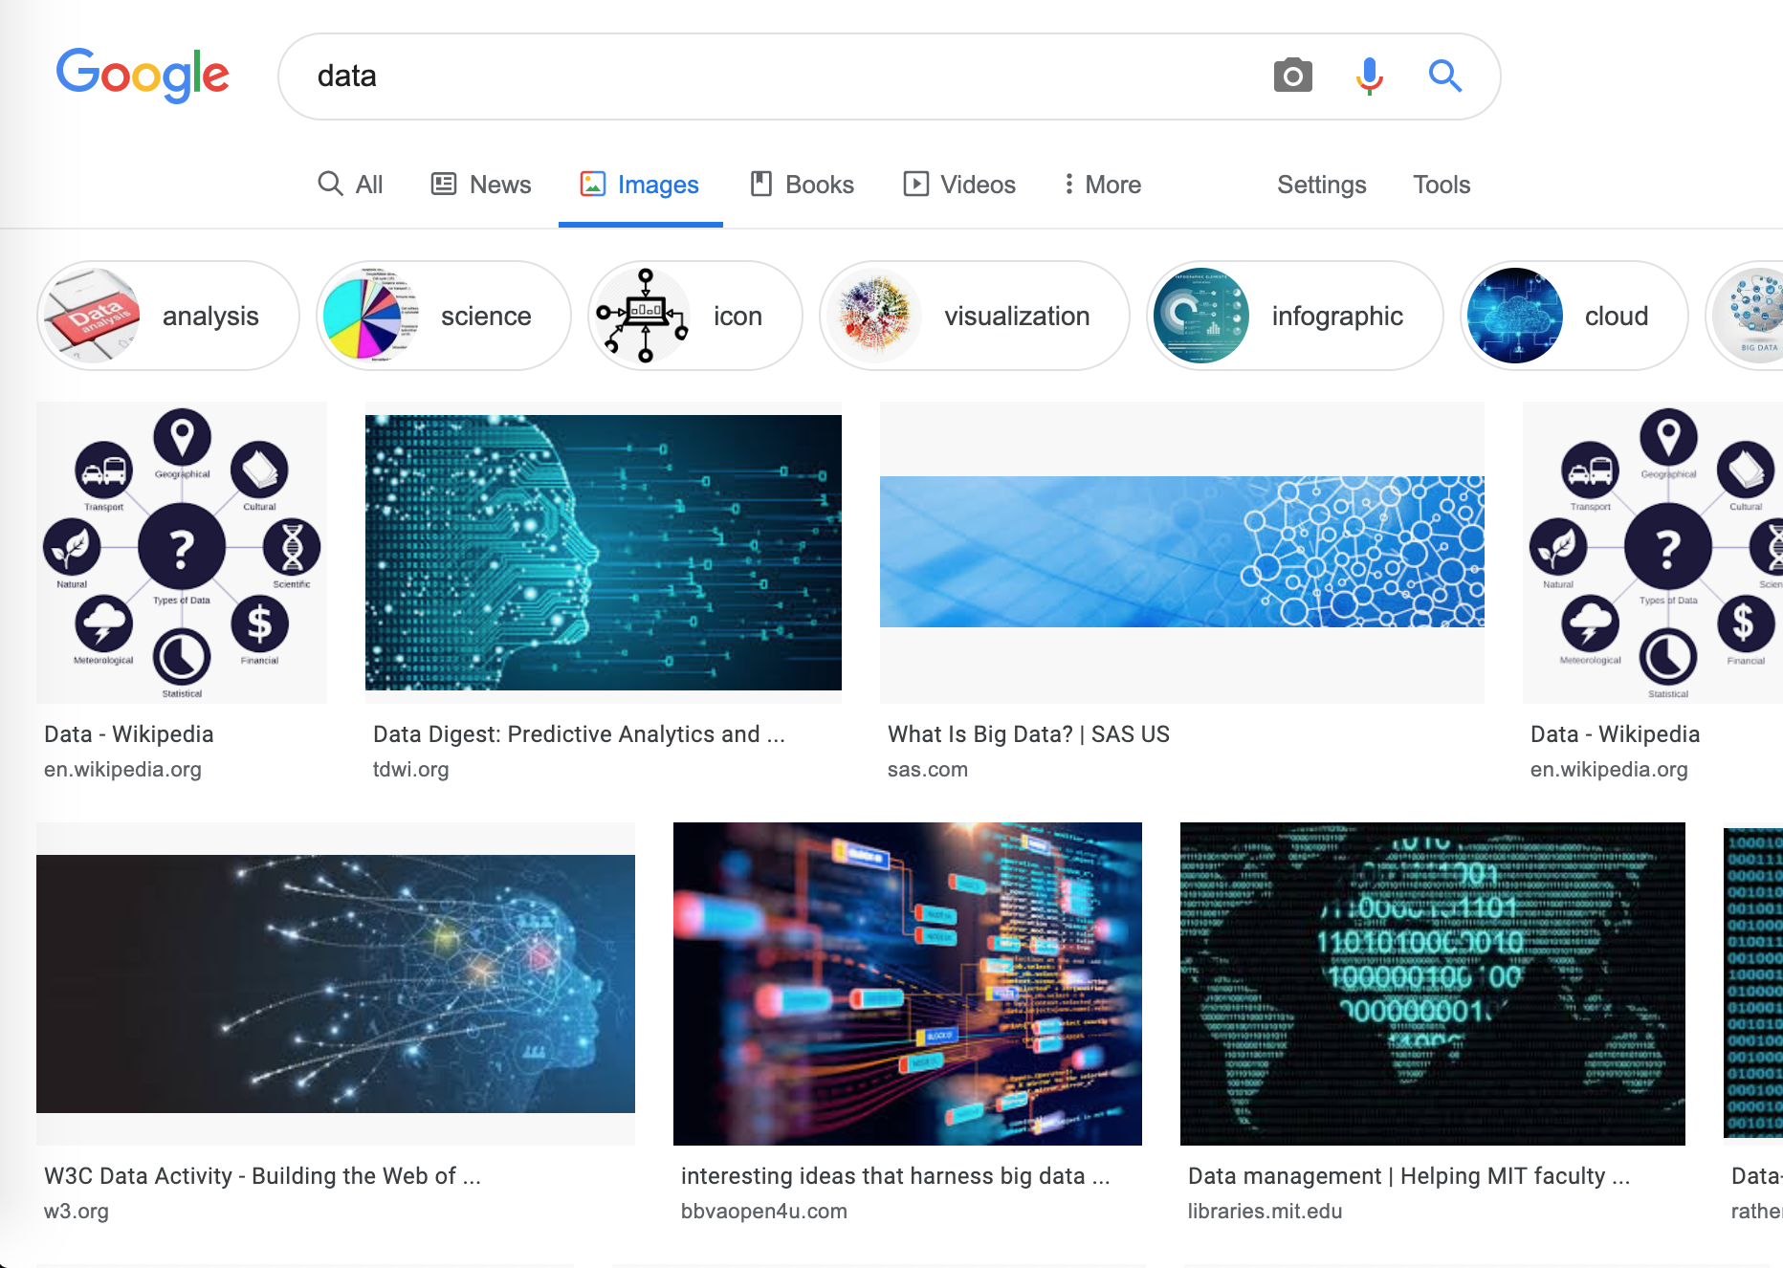
What is This “data”?

Slide 17
Tabular Data
Quick teaser. We’ll go into greater depth when discussing tidy data.
Data is an abstraction of some real world entity.
Also called: instance, example, record, object, case, individual.
Each of these entities is described by a set of features.
Sometimes called variables, features, attributes, …
Can be processed into an n (number of entities) by m (number of attributes) matrix.
Result of merging & processing different records!
Picking the data that goes into this table has both technical and ethical concerns (recall: Target, Netflix, AOL examples)
ID | Title | Author | Year | Cover | Edition | Price
1 | Emma | Austen | 1815 | Paper | 20th | $5.75
2 | Dracula | Stoker | 1897 | Hard | 15th | $12.00
3 | Ivanhoe | Scott | 1820 | Hard | 8th | $25.00
4 | Kidnapped | Stevenson | 1886 | Paper | 11th | $5.00

Slide 18
Classical Statistical View of Data
There are four classical types of data
Data Types
Categorical
Numerical
Interval
Ratio
Nominal
Ordinal

Slide 19


Categorical Data: Takes a Value From a Finite Set
Nominal (aka Categorical) Data:
Values have names: describe the categories, classes, or states of things
Marital status, drink type, or some binary attribute
Cannot compare easily, thus cannot naturally order them
Ordinal Data:
Values have names: describe the categories, classes, or states of things
However, there is an ordering over the values:
Strongly like, like, neutral, strongly dislike
Lacks a mathematical notion of distance between the values
This distinction can be blurry…
Is there an ordering over: sunny, overcast, rainy?

Slide 20
Numerical Data: Measured Using Integers or Reals
Interval Scale:
Scale with fixed but arbitrary interval (e.g., dates)
The difference between two values is meaningful:
Difference between 9/8/2020 and 10/8/2020 is the same as the difference between 9/8/2019 and 10/8/2019
Can’t compute ratios or scales: e.g., what unit is 9/8/2020 * 8/2/2021?
Ratio Scale:
All the same properties as interval scale data, but the scale of measurement also possesses a true-zero origin
Can look at the ratio of two quantities (unlike interval)
E.g., zero money is an absolute, one money is half as much as two money, and so on

Slide 21

Numerical Data: Examples
Temperatures:
Celsius / Fahrenheit: interval or ratio scale ???????????
Interval: 0C is not 0 heat, but is an arbitrary fixed point
Hence, we can’t say that 30F is twice as warm as 15F.
Kelvin (K): interval or ratio scale ???????????
Ratio: 0K is assumed to mean zero heat, a true fixed point
Weight:
Grams: interval or ratio scale ??????????
Ratio: 0g served as fixed point, 4g is twice 2g, …

Slide 22
General Rules
OK to compute.... | Nominal | Ordinal | Interval | Ratio
frequency distribution | Yes | Yes | Yes | Yes
median and percentiles | No | Yes | Yes | Yes
add or subtract | No | No | Yes | Yes
mean, standard deviation, standard error of the mean | No | No | Yes | Yes
ratio, or coefficient of variation | No | No | No | Yes
?
?
?
?
Thanks to GraphPad

Slide 23
General Rules
OK to compute.... | Nominal | Ordinal | Interval | Ratio
frequency distribution | Yes | Yes | Yes | Yes
median and percentiles | No | Yes | Yes | Yes
add or subtract | No | No | Yes | Yes
mean, standard deviation, standard error of the mean | No | No | Yes | Yes
ratio, or coefficient of variation | No | No | No | Yes
?
?
?
?

Slide 24
General Rules
OK to compute.... | Nominal | Ordinal | Interval | Ratio
frequency distribution | Yes | Yes | Yes | Yes
median and percentiles | No | Yes | Yes | Yes
addition or subtraction | No | No | Yes | Yes
mean, standard deviation, standard error of the mean | No | No | Yes | Yes
ratio, or coefficient of variation | No | No | No | Yes
?
?
?
?

Slide 25
General Rules
OK to compute.... | Nominal | Ordinal | Interval | Ratio
frequency distribution | Yes | Yes | Yes | Yes
median and percentiles | No | Yes | Yes | Yes
addition or subtraction | No | No | Yes | Yes
mean or standard deviation | No | No | Yes | Yes
ratio, or coefficient of variation | No | No | No | Yes
?
?
?
?

Slide 26
General Rules
OK to compute.... | Nominal | Ordinal | Interval | Ratio
frequency distribution | Yes | Yes | Yes | Yes
median and percentiles | No | Yes | Yes | Yes
addition or subtraction | No | No | Yes | Yes
mean or standard deviation | No | No | Yes | Yes
ratio, or coefficient of variation | No | No | No | Yes
?
?
?
?
Notes:
Coefficient of variation aka “relative standard deviation” – generally the ratio of the standard deviation to the mean of the sample – 0% = point (stdev 0 divided by mean), higher is more variable

Slide 27
General Rules
OK to compute.... | Nominal | Ordinal | Interval | Ratio
frequency distribution | Yes | Yes | Yes | Yes
median and percentiles | No | Yes | Yes | Yes
addition or subtraction | No | No | Yes | Yes
mean or standard deviation | No | No | Yes | Yes
ratio, or coefficient of variation | No | No | No | Yes
Notes:
Coefficient of variation aka “relative standard deviation” – generally the ratio of the standard deviation to the mean of the sample – 0% = point (stdev 0 divided by mean), higher is more variable

Slide 28
Data Manipulation and Computation
Data Science == manipulating and computing on data
Large to very large, but somewhat “structured” data
We will see several tools for doing that this semester
Thousands more out there that we won’t cover
Need to learn to shift thinking from:
Imperative code to manipulate data structures
to:
Sequences/pipelines of operations on data
Should still know how to implement the operations themselves, especially for debugging performance (covered in classes like 420, 424), but we won’t cover that much

Slide 29
Data Manipulation and Computation
Data Representation, i.e., what is the natural way to think about given data
Data Processing Operations, which take one or more datasets as input and produce one or more datasets as output
Indexing
Slicing/subsetting
Filter
‘map’ → apply a function to every element
’reduce/aggregate’ → combine values to get a single scalar (e.g., sum, median)
Given two vectors: Dot and cross products
One-dimensional Arrays, Vectors
0.1 | 2 | 3.2 | 6.5 | 3.4 | 4.1
“data” | ”representation” | ”i.e.”

Slide 30
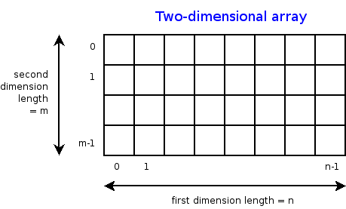
Data Manipulation and Computation
Data Representation, i.e., what is the natural way to think about given data
Data Processing Operations, which take one or more datasets as input and produce one or more datasets as output
Indexing
Slicing/subsetting
Filter
‘map’ → apply a function to every element
’reduce/aggregate’ → combine values across a row or a column (e.g., sum, average, median etc..)
n-dimensional arrays

Slide 31
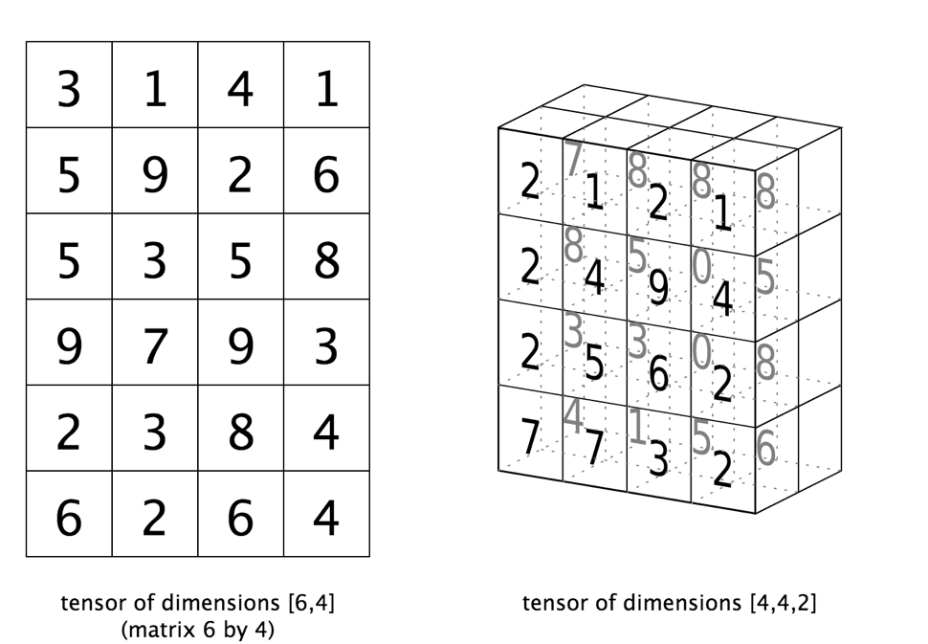
Data Manipulation and Computation
Data Representation, i.e., what is the natural way to think about given data
Data Processing Operations, which take one or more datasets as input and produce one or more datasets as output
Matrices, Tensors
n-dimensional array operations
+
Linear Algebra
Matrix/tensor multiplication
Transpose
Matrix-vector multiplication
Matrix factorization

Slide 32
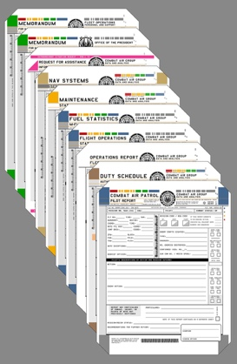
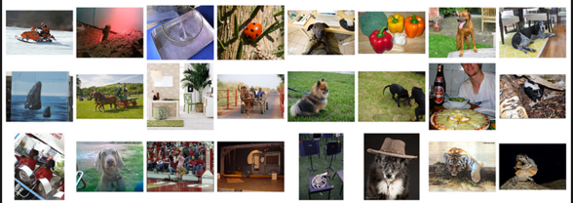
Data Manipulation and Computation
Data Representation, i.e., what is the natural way to think about given data
Data Processing Operations, which take one or more datasets as input and produce one or more datasets as output
Sets: of Objects
Filter
Map
Union
Reduce/Aggregate
Given two sets, Combine/Join using “keys”
Group and then aggregate
Sets: of (Key, Value Pairs)
(amol@cs.umd.edu,(email1, email2,…))
(john@cs.umd.edu,(email3, email4,…))

Slide 33
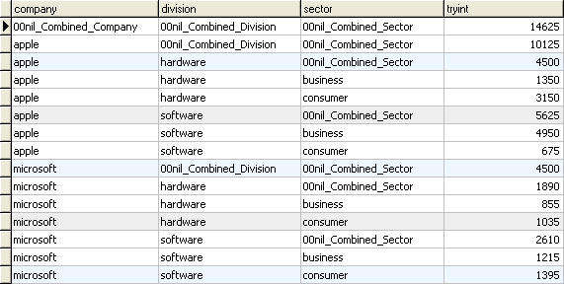
Data Manipulation and Computation
Data Representation, i.e., what is the natural way to think about given data
Data Processing Operations, which take one or more datasets as input and produce one or more datasets as output
Filter rows or columns
”Join” two or more relations
”Group” and “aggregate” them
Relational Algebra formalizes some of them
Structured Query Language (SQL)
Many other languages and constructs, that look very similar
Tables/Relations == Sets of Tuples

Slide 34
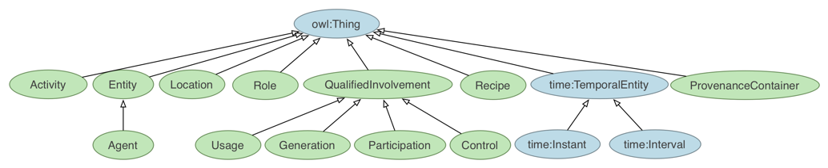
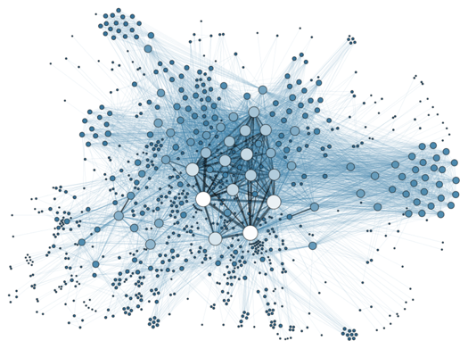
Data Manipulation and Computation
Data Representation, i.e., what is the natural way to think about given data
Data Processing Operations, which take one or more datasets as input and produce one or more datasets as output
Hierarchies/Trees/Graphs
”Path” queries
Graph Algorithms and Transformations
Network Science
Somewhat more ad hoc and special-purpose
Changing in recent years

Slide 35
Data Manipulation and Computation
Data Representation, i.e., what is the natural way to think about given data
Data Processing Operations, which take one or more datasets as input and produce
Why?
Allows one to think at a higher level of abstraction, leading to simpler and easier-to-understand scripts
Provides ”independence” between the abstract operations and concrete implementation
Can switch from one implementation to another easily
For performance debugging, useful to know how they are implemented and rough characteristics

Slide 36
The Rest of Today’s Lecture
Data collection
Data processing
Exploratory analysis
&
Data viz
Analysis, hypothesis testing, & ML
Insight & Policy Decision
… on to the “collection” part of things …

Slide 37
GotTa Catch ‘Em All
Five ways to get data:
Direct download and load from local storage
Generate locally via downloaded code (e.g., simulation)
Query data from a database (covered in a few lectures)
Query an API from the intra/internet
Scrape data from a webpage
Covered today.

Slide 38
Wherefore art thou, API?
A web-based Application Programming Interface (API) like we’ll be using in this class is a contract between a server and a user stating:
“If you send me a specific request, I will return some information in a structured and documented format.”
(More generally, APIs can also perform actions, may not be web-based, be a set of protocols for communicating between processes, between an application and an OS, etc.)
Notes:
”Wherefore” means “why”, not “where”!

Slide 39
“Send me a specific request”
Most web API queries we’ll be doing will use HTTP requests:
conda install –c anaconda requests=2.12.4
r = requests.get( 'https://api.github.com/user', auth=('user', 'pass') )
r.status_code
200
r.headers[‘content-type’]
‘application/json; charset=utf8’
r.json()
{u'private_gists': 419, u'total_private_repos': 77, ...}
http://docs.python-requests.org/en/master/

Slide 40
HTTP Requests
https://www.google.com/?q=cmsc320&tbs=qdr:m
HTTP GET Request:
GET /?q=cmsc320&tbs=qdr:m HTTP/1.1 Host: www.google.com User-Agent: Mozilla/5.0 (X11; Linux x86_64; rv:10.0.1) Gecko/20100101 Firefox/10.0.1
??????????
params = { “q”: “cmsc320”, “tbs”: “qdr:m” }
r = requests.get( “https://www.google.com”, params = params )
*be careful with https:// calls; requests will not verify SSL by default

Slide 41
Restful APIs
This class will just query web APIs, but full web APIs typically allow more.
Representational State Transfer (RESTful) APIs:
GET: perform query, return data
POST: create a new entry or object
PUT: update an existing entry or object
DELETE: delete an existing entry or object
Can be more intricate, but verbs (“put”) align with actions

Slide 42
Querying a Restful API
Stateless: with every request, you send along a token/authentication of who you are
GitHub is more than a GETHub:
PUT/POST/DELETE can edit your repositories, etc.
Try it out: https://github.com/settings/tokens/new
token = ”super_secret_token”
r = requests.get(“https://github.com/user”,
params={”access_token”: token})
print( r.content )
{"login":”JohnDickerson","id":472985,"avatar_url":"ht…

Slide 43
Authentication and OAuth
Old and busted:
New hotness:
What if I wanted to grant an app access to, e.g., my Facebook account without giving that app my password?
OAuth: grants access tokens that give (possibly incomplete) access to a user or app without exposing a password
r = requests.get(“https://api.github.com/user”,
auth=(“JohnDickerson”, “ILoveKittens”))

Slide 44
“… I will return information in a structured format.”
So we’ve queried a server using a well-formed GET request via the requests Python module. What comes back?
General structured data:
Comma-Separated Value (CSV) files & strings
Javascript Object Notation (JSON) files & strings
HTML, XHTML, XML files & strings
Domain-specific structured data:
Shapefiles: geospatial vector data (OpenStreetMap)
RVT files: architectural planning (Autodesk Revit)
You can make up your own! Always document it.

Slide 45
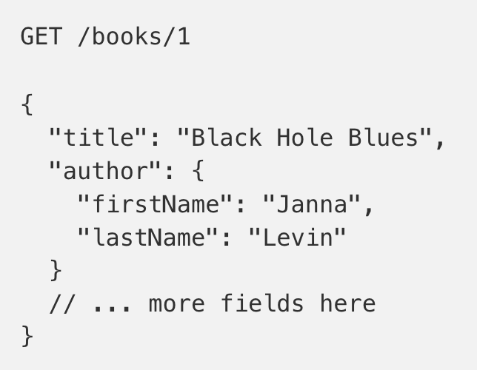
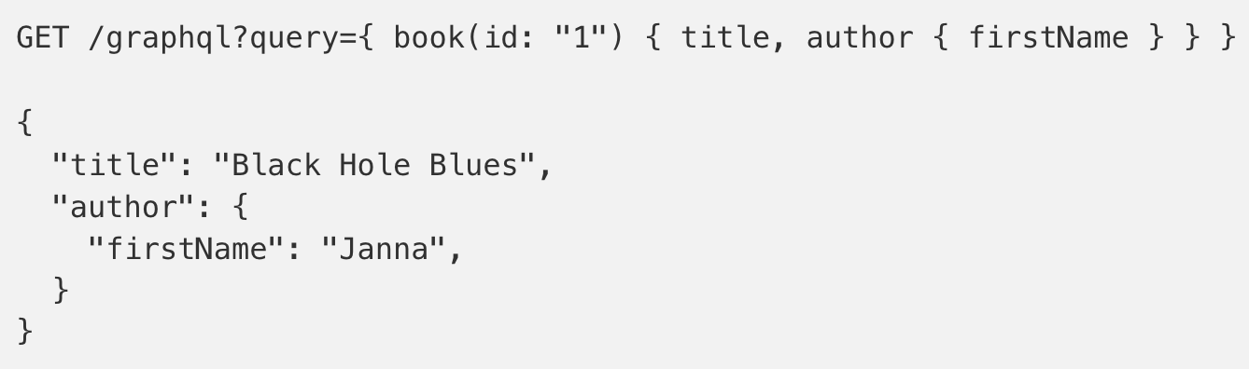
GraphQL?
An alternative to REST and ad-hoc webservice architectures
Developed internally by Facebook and released publicly
Unlike REST, the requester specifies the format of the response
https://dev-blog.apollodata.com/graphql-vs-rest-5d425123e34b

Slide 46
CSV Files in Python
Any CSV reader worth anything can parse files with any delimiter, not just a comma (e.g., “TSV” for tab-separated)
1,26-Jan,Introduction,—,"pdf, pptx",Dickerson, 2,31-Jan,Scraping Data with Python,Anaconda's Test Drive.,,Dickerson, 3,2-Feb,"Vectors, Matrices, and Dataframes",Introduction to pandas.,,Dickerson, 4,7-Feb,Jupyter notebook lab,,,"Denis, Anant, & Neil", 5,9-Feb,Best Practices for Data Science Projects,,,Dickerson,
Don’t write your own CSV or JSON parser
(We’ll use pandas to do this much more easily and efficiently)
import csv
with open(“schedule.csv”, ”rb”) as f:
reader = csv.reader(f, delimiter=“,”, quotechar=’”’)
for row in reader:
print(row)

Slide 47
JSON Files & Strings
JSON is a method for serializing objects:
Convert an object into a string (done in Java in 131/132?)
Deserialization converts a string back to an object
Easy for humans to read (and sanity check, edit)
Defined by three universal data structures
Python dictionary, Java Map, hash table, etc …
Python list, Java array, vector, etc …
Python string, float, int, boolean, JSON object, JSON array, …
Images from: http://www.json.org/

Slide 48
JSON In Python
Some built-in types: “Strings”, 1.0, True, False, None
Lists: [“Goodbye”, “Cruel”, “World”]
Dictionaries: {“hello”: “bonjour”, “goodbye”, “au revoir”}
Dictionaries within lists within dictionaries within lists:
[1, 2, {“Help”:[ “I’m”, {“trapped”: “in”}, “CMSC320” ]}]

Slide 49
JSON From Twitter
GET https://api.twitter.com/1.1/friends/list.json?cursor=-1&screen_name=twitterapi&skip_status=true&include_user_entities=false
{ "previous_cursor": 0,
"previous_cursor_str": "0",
"next_cursor": 1333504313713126852,
"users": [{
"profile_sidebar_fill_color": "252429",
"profile_sidebar_border_color": "181A1E",
"profile_background_tile": false,
"name": "Sylvain Carle",
"profile_image_url": "http://a0.twimg.com/profile_images/2838630046/4b82e286a659fae310012520f4f756bb_normal.png",
"created_at": "Thu Jan 18 00:10:45 +0000 2007", …

Slide 50
Parsing JSON In Python
Repeat: don’t write your own CSV or JSON parser
https://news.ycombinator.com/item?id=7796268
rsdy.github.io/posts/dont_write_your_json_parser_plz.html
Python comes with a fine JSON parser
import json
r = requests.get( “https://api.twitter.com/1.1/statuses/user_timeline.json?screen_name=JohnPDickerson&count=100”, auth=auth )
data = json.loads(r.content)
json.load(some_file) # loads JSON from a file
json.dump(json_obj, some_file) # writes JSON to file
json.dumps(json_obj) # returns JSON string

Slide 51
XML, XHTML, HTML files and Strings
Still hugely popular online, but JSON has essentially replaced XML for:
Asynchronous browser ←→ server calls
Many (most?) newer web APIs
XML is a hierarchical markup language:
<tag attribute=“value1”> <subtag> Some content goes here </subtag> <openclosetag attribute=“value2” /> </tag>
You probably won’t see much XML, but you will see plenty of HTML, its substantially less well-behaved cousin …
Example XML from: Zico Kolter

Slide 52
Document Object Model (DOM)
XML encodes Document-Object Models (“the DOM”)
The DOM is tree-structured.
Easy to work with! Everything is encoded via links.
Can be huge, & mostly full of stuff you don’t need …

Slide 53
SAX
SAX (Simple API for XML) is an alternative “lightweight” way to process XML.
A SAX parser generates a stream of events as it parses the XML file. The programmer registers handlers for each one.
It allows a programmer to handle only parts of the data structure.
Example from John Canny

Slide 54
Scraping HTML in Python
HTML – the specification – is fairly pure
HTML – what you find on the web – is horrifying
We’ll use BeautifulSoup:
conda install -c asmeurer beautiful-soup=4.3.2
import requests
from bs4 import BeautifulSoup
r = requests.get( “https://cmsc320.github.io” )
root = BeautifulSoup( r.content )
root.find(“div”, id=“schedule”)\
.find(“table”)\ # find all schedule
.find(“tbody”).findAll(“a”) # links for CMSC320

Slide 55
Building a web scraper in python
Totally not hypothetical situation:
You really want to learn about data science, so you choose to download all of last semester’s CMSC320 lecture slides to wallpaper your room …
… but you now have carpal tunnel syndrome from clicking refresh on Piazza last night, and can no longer click on the PDF and PPTX links.
Hopeless? No! Earlier, you built a scraper to do this!
Sort of. You only want PDF and PPTX files, not links to other websites or files.
lnks = root.find(“div”, id=“schedule”)\
.find(“table”)\ # find all schedule
.find(“tbody”).findAll(“a”) # links for CMSC320

Slide 56
Regular Expressions
Given a list of URLs (strings), how do I find only those strings that end in *.pdf or *.pptx?
Regular expressions!
(Actually Python strings come with a built-in endswith function.)
What about .pDf or .pPTx, still legal extensions for PDF/PPTX?
Regular expressions!
(Or cheat the system again: built-in string lower function.)
“this_is_a_filename.pdf”.endswith((“.pdf”, “.pptx”))
“tHiS_IS_a_FileNAme.pDF”.lower().endswith( (“.pdf”, “.pptx”))

Slide 57
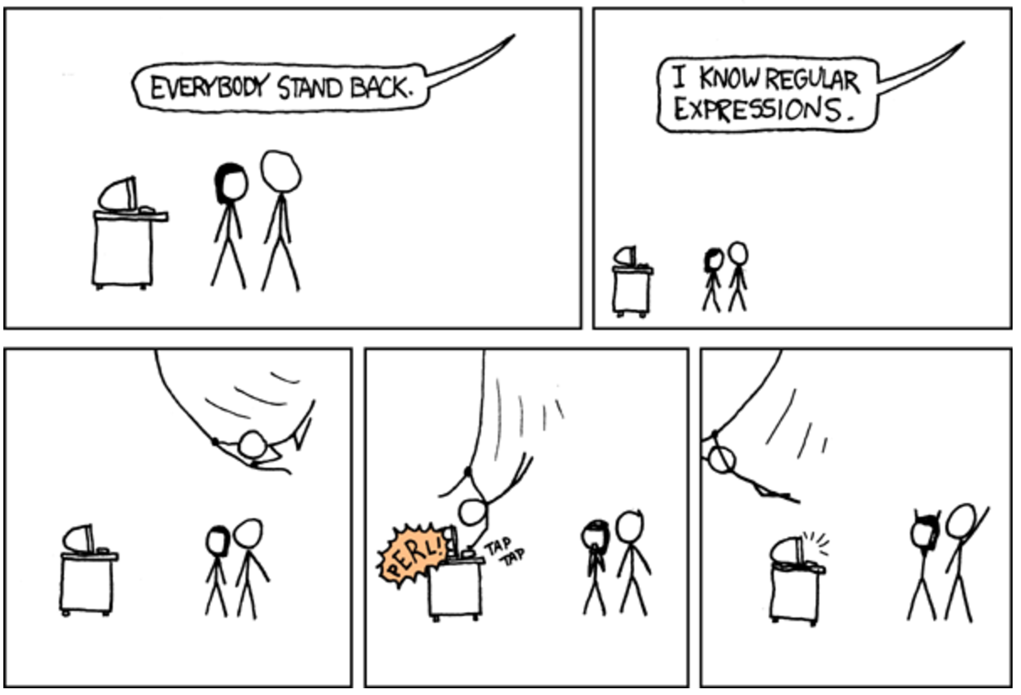

Slide 58
Regular Expressions
Used to search for specific elements, or groups of elements, that match a pattern
Indispensable for data munging and wrangling
Many constructs to search a variety of different patterns
Many languages/libraries (including Python) allow “compiling”
Much faster for repeated applications of the regex pattern
https://blog.codinghorror.com/to-compile-or-not-to-compile/

Slide 59
Regular Expressions
Used to search for specific elements, or groups of elements, that match a pattern
import re
# Find the index of the 1st occurrence of “cmsc320”
match = re.search(r”cmsc320”, text)
print( match.start() )
# Does start of text match “cmsc320”?
match = re.match(r”cmsc320”, text)
# Iterate over all matches for “cmsc320” in text
for match in re.finditer(r”cmsc320”, text):
print( match.start() )
# Return all matches of “cmsc320” in the text
match = re.findall(r”cmsc320”, text)

Slide 60
Matching Multiple Characters
Can match sets of characters, or multiple and more elaborate sets and sequences of characters:
Match the character ‘a’: a
Match the character ‘a’, ‘b’, or ‘c’: [abc]
Match any character except ‘a’, ‘b’, or ‘c’: [^abc]
Match any digit: \d (= [0123456789] or [0-9])
Match any alphanumeric: \w (= [a-zA-Z0-9_])
Match any whitespace: \s (= [ \t\n\r\f\v])
Match any character: .
Special characters must be escaped: .^$*+?{}\[]|()
Thanks to: Zico Kolter

Slide 61
Matching sequences and repeated characters
A few common modifiers (available in Python and most other high-level languages; +, {n}, {n,} may not):
Match character ‘a’ exactly once: a
Match character ‘a’ zero or once: a?
Match character ‘a’ zero or more times: a*
Match character ‘a’ one or more times: a+
Match character ‘a’ exactly n times: a{n}
Match character ‘a’ at least n times: a{n,}
Example: match all instances of “University of <somewhere>” where <somewhere> is an alphanumeric string with at least 3 characters:
\s*University\sof\s\w{3,}

Slide 62
Groups
What if we want to know more than just “did we find a match” or “where is the first match” …?
Grouping asks the regex matcher to keep track of certain portions – surrounded by (parentheses) – of the match
\s*([Uu]niversity)\s([Oo]f)\s(\w{3,})
regex = r”\s*([Uu]niversity)\s([Oo]f)\s(\w{3,})”
m = re.search( regex, “university Of Maryland” )
print( m.groups() )
('university', 'Of', 'Maryland')

Slide 63
Simple Example: Parse an Email Address
(?:(?:\r\n)?[ \t])*(?:(?:(?:[^()<>@,;:\\".\[\] \000-\031]+(?:(?:(?:\r\n)?[ \t] )+|\Z|(?=[\["()<>@,;:\\".\[\]]))|"(?:[^\"\r\\]|\\.|(?:(?:\r\n)?[ \t]))*"(?:(?: \r\n)?[ \t])*)(?:\.(?:(?:\r\n)?[ \t])*(?:[^()<>@,;:\\".\[\] \000-\031]+(?:(?:( ?:\r\n)?[ \t])+|\Z|(?=[\["()<>@,;:\\".\[\]]))|"(?:[^\"\r\\]|\\.|(?:(?:\r\n)?[ \t]))*"(?:(?:\r\n)?[ \t])*))*@(?:(?:\r\n)?[ \t])*(?:[^()<>@,;:\\".\[\] \000-\0 31]+(?:(?:(?:\r\n)?[ \t])+|\Z|(?=[\["()<>@,;:\\".\[\]]))|\[([^\[\]\r\\]|\\.)*\ ](?:(?:\r\n)?[ \t])*)(?:\.(?:(?:\r\n)?[ \t])*(?:[^()<>@,;:\\".\[\] \000-\031]+ (?:(?:(?:\r\n)?[ \t])+|\Z|(?=[\["()<>@,;:\\".\[\]]))|\[([^\[\]\r\\]|\\.)*\](?: (?:\r\n)?[ \t])*))*|(?:[^()<>@,;:\\".\[\] \000-\031]+(?:(?:(?:\r\n)?[ \t])+|\Z |(?=[\["()<>@,;:\\".\[\]]))|"(?:[^\"\r\\]|\\.|(?:(?:\r\n)?[ \t]))*"(?:(?:\r\n) ?[ \t])*)*\<(?:(?:\r\n)?[ \t])*(?:@(?:[^()<>@,;:\\".\[\] \000-\031]+(?:(?:(?:\ r\n)?[ \t])+|\Z|(?=[\["()<>@,;:\\".\[\]]))|\[([^\[\]\r\\]|\\.)*\](?:(?:\r\n)?[ \t])*)(?:\.(?:(?:\r\n)?[ \t])*(?:[^()<>@,;:\\".\[\] \000-\031]+(?:(?:(?:\r\n) ?[ \t])+|\Z|(?=[\["()<>@,;:\\".\[\]]))|\[([^\[\]\r\\]|\\.)*\](?:(?:\r\n)?[ \t] )*))*(?:,@(?:(?:\r\n)?[ \t])*(?:[^()<>@,;:\\".\[\] \000-\031]+(?:(?:(?:\r\n)?[ \t])+|\Z|(?=[\["()<>@,;:\\".\[\]]))|\[([^\[\]\r\\]|\\.)*\](?:(?:\r\n)?[ \t])* )(?:\.(?:(?:\r\n)?[ \t])*(?:[^()<>@,;:\\".\[\] \000-\031]+(?:(?:(?:\r\n)?[ \t] )+|\Z|(?=[\["()<>@,;:\\".\[\]]))|\[([^\[\]\r\\]|\\.)*\](?:(?:\r\n)?[ \t])*))*) *:(?:(?:\r\n)?[ \t])*)?(?:[^()<>@,;:\\".\[\] \000-\031]+(?:(?:(?:\r\n)?[ \t])+ |\Z|(?=[\["()<>@,;:\\".\[\]]))|"(?:[^\"\r\\]|\\.|(?:(?:\r\n)?[ \t]))*"(?:(?:\r \n)?[ \t])*)(?:\.(?:(?:\r\n)?[ \t])*(?:[^()<>@,;:\\".\[\] \000-\031]+(?:(?:(?: \r\n)?[ \t])+|\Z|(?=[\["()<>@,;:\\".\[\]]))|"(?:[^\"\r\\]|\\.|(?:(?:\r\n)?[ \t ]))*"(?:(?:\r\n)?[ \t])*))*@(?:(?:\r\n)?[ \t])*(?:[^()<>@,;:\\".\[\] \000-\031 ]+(?:(?:(?:\r\n)?[ \t])+|\Z|(?=[\["()<>@,;:\\".\[\]]))|\[([^\[\]\r\\]|\\.)*\]( ?:(?:\r\n)?[ \t])*)(?:\.(?:(?:\r\n)?[ \t])*(?:[^()<>@,;:\\".\[\] \000-\031]+(? :(?:(?:\r\n)?[ \t])+|\Z|(?=[\["()<>@,;:\\".\[\]]))|\[([^\[\]\r\\]|\\.)*\](?:(? :\r\n)?[ \t])*))*\>(?:(?:\r\n)?[ \t])*)|(?:[^()<>@,;:\\".\[\] \000-\031]+(?:(? :(?:\r\n)?[ \t])+|\Z|(?=[\["()<>@,;:\\".\[\]]))|"(?:[^\"\r\\]|\\.|(?:(?:\r\n)? [ \t]))*"(?:(?:\r\n)?[ \t])*)*:(?:(?:\r\n)?[ \t])*(?:(?:(?:[^()<>@,;:\\".\[\] \000-\031]+(?:(?:(?:\r\n)?[ \t])+|\Z|(?=[\["()<>@,;:\\".\[\]]))|"(?:[^\"\r\\]| \\.|(?:(?:\r\n)?[ \t]))*"(?:(?:\r\n)?[ \t])*)(?:\.(?:(?:\r\n)?[ \t])*(?:[^()<> @,;:\\".\[\] \000-\031]+(?:(?:(?:\r\n)?[ \t])+|\Z|(?=[\["()<>@,;:\\".\[\]]))|" (?:[^\"\r\\]|\\.|(?:(?:\r\n)?[ \t]))*"(?:(?:\r\n)?[ \t])*))*@(?:(?:\r\n)?[ \t] )*(?:[^()<>@,;:\\".\[\] \000-\031]+(?:(?:(?:\r\n)?[ \t])+|\Z|(?=[\["()<>@,;:\\ ".\[\]]))|\[([^\[\]\r\\]|\\.)*\](?:(?:\r\n)?[ \t])*)(?:\.(?:(?:\r\n)?[ \t])*(? :[^()<>@,;:\\".\[\] \000-\031]+(?:(?:(?:\r\n)?[ \t])+|\Z|(?=[\["()<>@,;:\\".\[ \]]))|\[([^\[\]\r\\]|\\.)*\](?:(?:\r\n)?[ \t])*))*|(?:[^()<>@,;:\\".\[\] \000- \031]+(?:(?:(?:\r\n)?[ \t])+|\Z|(?=[\["()<>@,;:\\".\[\]]))|"(?:[^\"\r\\]|\\.|( ?:(?:\r\n)?[ \t]))*"(?:(?:\r\n)?[ \t])*)*\<(?:(?:\r\n)?[ \t])*(?:@(?:[^()<>@,; :\\".\[\] \000-\031]+(?:(?:(?:\r\n)?[ \t])+|\Z|(?=[\["()<>@,;:\\".\[\]]))|\[([ ^\[\]\r\\]|\\.)*\](?:(?:\r\n)?[ \t])*)(?:\.(?:(?:\r\n)?[ \t])*(?:[^()<>@,;:\\" .\[\] \000-\031]+(?:(?:(?:\r\n)?[ \t])+|\Z|(?=[\["()<>@,;:\\".\[\]]))|\[([^\[\ ]\r\\]|\\.)*\](?:(?:\r\n)?[ \t])*))*(?:,@(?:(?:\r\n)?[ \t])*(?:[^()<>@,;:\\".\ [\] \000-\031]+(?:(?:(?:\r\n)?[ \t])+|\Z|(?=[\["()<>@,;:\\".\[\]]))|\[([^\[\]\ r\\]|\\.)*\](?:(?:\r\n)?[ \t])*)(?:\.(?:(?:\r\n)?[ \t])*(?:[^()<>@,;:\\".\[\] \000-\031]+(?:(?:(?:\r\n)?[ \t])+|\Z|(?=[\["()<>@,;:\\".\[\]]))|\[([^\[\]\r\\] |\\.)*\](?:(?:\r\n)?[ \t])*))*)*:(?:(?:\r\n)?[ \t])*)?(?:[^()<>@,;:\\".\[\] \0 00-\031]+(?:(?:(?:\r\n)?[ \t])+|\Z|(?=[\["()<>@,;:\\".\[\]]))|"(?:[^\"\r\\]|\\ .|(?:(?:\r\n)?[ \t]))*"(?:(?:\r\n)?[ \t])*)(?:\.(?:(?:\r\n)?[ \t])*(?:[^()<>@, ;:\\".\[\] \000-\031]+(?:(?:(?:\r\n)?[ \t])+|\Z|(?=[\["()<>@,;:\\".\[\]]))|"(? :[^\"\r\\]|\\.|(?:(?:\r\n)?[ \t]))*"(?:(?:\r\n)?[ \t])*))*@(?:(?:\r\n)?[ \t])* (?:[^()<>@,;:\\".\[\] \000-\031]+(?:(?:(?:\r\n)?[ \t])+|\Z|(?=[\["()<>@,;:\\". \[\]]))|\[([^\[\]\r\\]|\\.)*\](?:(?:\r\n)?[ \t])*)(?:\.(?:(?:\r\n)?[ \t])*(?:[ ^()<>@,;:\\".\[\] \000-\031]+(?:(?:(?:\r\n)?[ \t])+|\Z|(?=[\["()<>@,;:\\".\[\] ]))|\[([^\[\]\r\\]|\\.)*\](?:(?:\r\n)?[ \t])*))*\>(?:(?:\r\n)?[ \t])*)(?:,\s*( ?:(?:[^()<>@,;:\\".\[\] \000-\031]+(?:(?:(?:\r\n)?[ \t])+|\Z|(?=[\["()<>@,;:\\ ".\[\]]))|"(?:[^\"\r\\]|\\.|(?:(?:\r\n)?[ \t]))*"(?:(?:\r\n)?[ \t])*)(?:\.(?:( ?:\r\n)?[ \t])*(?:[^()<>@,;:\\".\[\] \000-\031]+(?:(?:(?:\r\n)?[ \t])+|\Z|(?=[ \["()<>@,;:\\".\[\]]))|"(?:[^\"\r\\]|\\.|(?:(?:\r\n)?[ \t]))*"(?:(?:\r\n)?[ \t ])*))*@(?:(?:\r\n)?[ \t])*(?:[^()<>@,;:\\".\[\] \000-\031]+(?:(?:(?:\r\n)?[ \t ])+|\Z|(?=[\["()<>@,;:\\".\[\]]))|\[([^\[\]\r\\]|\\.)*\](?:(?:\r\n)?[ \t])*)(? :\.(?:(?:\r\n)?[ \t])*(?:[^()<>@,;:\\".\[\] \000-\031]+(?:(?:(?:\r\n)?[ \t])+| \Z|(?=[\["()<>@,;:\\".\[\]]))|\[([^\[\]\r\\]|\\.)*\](?:(?:\r\n)?[ \t])*))*|(?: [^()<>@,;:\\".\[\] \000-\031]+(?:(?:(?:\r\n)?[ \t])+|\Z|(?=[\["()<>@,;:\\".\[\ ]]))|"(?:[^\"\r\\]|\\.|(?:(?:\r\n)?[ \t]))*"(?:(?:\r\n)?[ \t])*)*\<(?:(?:\r\n) ?[ \t])*(?:@(?:[^()<>@,;:\\".\[\] \000-\031]+(?:(?:(?:\r\n)?[ \t])+|\Z|(?=[\[" ()<>@,;:\\".\[\]]))|\[([^\[\]\r\\]|\\.)*\](?:(?:\r\n)?[ \t])*)(?:\.(?:(?:\r\n) ?[ \t])*(?:[^()<>@,;:\\".\[\] \000-\031]+(?:(?:(?:\r\n)?[ \t])+|\Z|(?=[\["()<> @,;:\\".\[\]]))|\[([^\[\]\r\\]|\\.)*\](?:(?:\r\n)?[ \t])*))*(?:,@(?:(?:\r\n)?[ \t])*(?:[^()<>@,;:\\".\[\] \000-\031]+(?:(?:(?:\r\n)?[ \t])+|\Z|(?=[\["()<>@, ;:\\".\[\]]))|\[([^\[\]\r\\]|\\.)*\](?:(?:\r\n)?[ \t])*)(?:\.(?:(?:\r\n)?[ \t] )*(?:[^()<>@,;:\\".\[\] \000-\031]+(?:(?:(?:\r\n)?[ \t])+|\Z|(?=[\["()<>@,;:\\ ".\[\]]))|\[([^\[\]\r\\]|\\.)*\](?:(?:\r\n)?[ \t])*))*)*:(?:(?:\r\n)?[ \t])*)? (?:[^()<>@,;:\\".\[\] \000-\031]+(?:(?:(?:\r\n)?[ \t])+|\Z|(?=[\["()<>@,;:\\". \[\]]))|"(?:[^\"\r\\]|\\.|(?:(?:\r\n)?[ \t]))*"(?:(?:\r\n)?[ \t])*)(?:\.(?:(?: \r\n)?[ \t])*(?:[^()<>@,;:\\".\[\] \000-\031]+(?:(?:(?:\r\n)?[ \t])+|\Z|(?=[\[ "()<>@,;:\\".\[\]]))|"(?:[^\"\r\\]|\\.|(?:(?:\r\n)?[ \t]))*"(?:(?:\r\n)?[ \t]) *))*@(?:(?:\r\n)?[ \t])*(?:[^()<>@,;:\\".\[\] \000-\031]+(?:(?:(?:\r\n)?[ \t]) +|\Z|(?=[\["()<>@,;:\\".\[\]]))|\[([^\[\]\r\\]|\\.)*\](?:(?:\r\n)?[ \t])*)(?:\ .(?:(?:\r\n)?[ \t])*(?:[^()<>@,;:\\".\[\] \000-\031]+(?:(?:(?:\r\n)?[ \t])+|\Z |(?=[\["()<>@,;:\\".\[\]]))|\[([^\[\]\r\\]|\\.)*\](?:(?:\r\n)?[ \t])*))*\>(?:( ?:\r\n)?[ \t])*))*)?;\s*)
Mail::RFC822::Address Perl module for RFC 822

Slide 64
Named Groups
Raw grouping is useful for one-off exploratory analysis, but may get confusing with longer regexes
Much scarier regexes than that email one exist in the wild …
Named groups let you attach position-independent identifiers to groups in a regex
(?P<some_name> …)
regex = "\s*[Uu]niversity\s[Oo]f\s(?P<school>(\w{3,}))"
m = re.search( regex, “University of Maryland” )
print( m.group(‘school’) )
'Maryland'

Slide 65
Substitutions
The Python string module contains basic functionality for find-and-replace within strings:
For more complicated stuff, use regexes:
Can incorporate groups into the matching
”abcabcabc”.replace(“a”, ”X”)
‘XbcXbcXbc`
text = “I love Introduction to Data Science”
re.sub(r”Data Science”, r”Schmada Schmience”, text)
‘I love Introduction to Schmada Schmience`
re.sub(r”(\w+)\s([Ss]cience”, r”\1 \2hmience”, text)
Thanks to: Zico Kolter

Slide 66
Compiled Regexes
If you’re going to reuse the same regex many times, or if you aren’t but things are going slowly for some reason, try compiling the regular expression.
https://blog.codinghorror.com/to-compile-or-not-to-compile/
Interested? CMSC330, CMSC430, CMSC452, talk to me.
# Compile the regular expression “cmsc320”
regex = re.compile(r”cmsc320”)
# Use it repeatedly to search for matches in text
regex.match( text ) # does start of text match?
regex.search( text ) # find the first match or None
regex.findall( text ) # find all matches

Slide 67
Downloading a bunch of files
Import the modules
import re
import requests
from bs4 import BeautifulSoup
try:
from urllib.parse import urlparse
except ImportError:
from urlparse import urlparse
Get some HTML via HTTP
# HTTP GET request sent to the URL url
r = requests.get( url )
# Use BeautifulSoup to parse the GET response
root = BeautifulSoup( r.content )
lnks = root.find("div", id="schedule")\
.find("table")\
.find("tbody").findAll("a")

Slide 68
Downloading a bunch of files
Parse exactly what you want
# Cycle through the href for each anchor, checking
# to see if it's a PDF/PPTX link or not
for lnk in lnks:
href = lnk['href']
# If it's a PDF/PPTX link, queue a download
if href.lower().endswith(('.pdf', '.pptx')):
Get some more data?!
urld = urlparse.urljoin(url, href)
rd = requests.get(urld, stream=True)
# Write the downloaded PDF to a file
outfile = path.join(outbase, href)
with open(outfile, 'wb') as f:
f.write(rd.content)

Slide 69
Next Lecture
Data collection
Data processing
Exploratory analysis
&
Data viz
Analysis, hypothesis testing, & ML
Insight & Policy Decision

Slide 70
Next Class: NumPy, Scipy, And DataFrames

